Slide 1
Security Overlay Of Enterprise (Part 3)
General security design principles

Slide 2
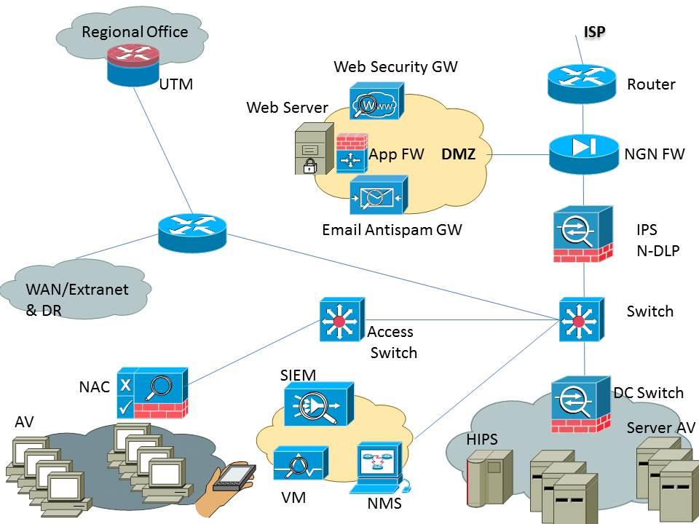
Security Overlay Of Enterprise (Part 3)

Slide 3
Security Overlay Of Enterprise (Part 3)
Block unauthorized traffic at edge (direct public www traffic to DMZ web server)
Edge malware protection & DMZ
Web & email are important vectors to secure against malware and attacks
NGN-FW (may be found in a UTM as well)

Slide 4
Security Overlay Of Enterprise (Part 3)
Web security GW and email anti-spam GW solutions
Granular access list filtering in edge and data center FWs (source, destination, and traffic type/port)
A good AV solution, and keep virus definitions updated
Monthly VM scans

Slide 5
Security Overlay Of Enterprise (Part 3)
More Advanced Security:
APT & zero-day attack prevention
SIEM solution
Network DLP and system DLP
Network admission control (NAC)
Server HIPS
Web application FW (WAF)

Slide 6
Security Overlay Of Enterprise (Part 3)
Even More Advanced Security:
Network forensics
Host-based APT / IoC solution
Identity & access management (IAM)
Privileged identity management (PIM)
Database security solution

Slide 7
Security Overlay Of Enterprise (Part 3)
Further guidelines for strong security controls:
CIS 20 critical security controls

Slide 8
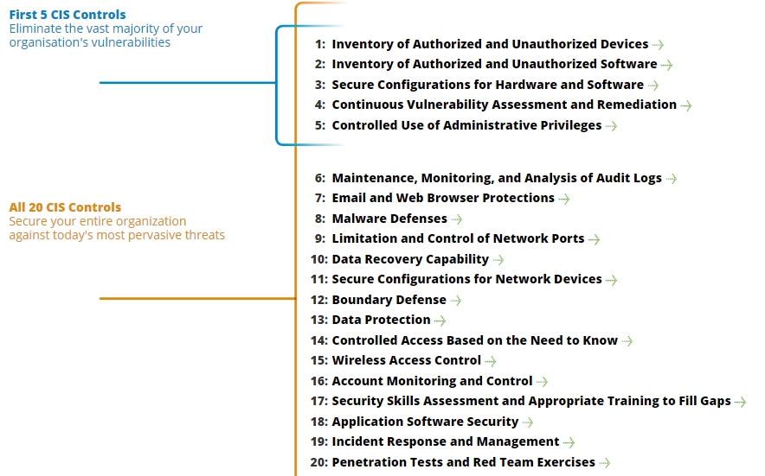

Security Overlay Of Enterprise (Part 3)
Further guidelines for strong security controls:
CIS 20 critical security controls

Slide 9
Security Overlay Of Enterprise (Part 3)
Further guidelines for strong security controls:
CIS 20 critical security controls

